Slide 1

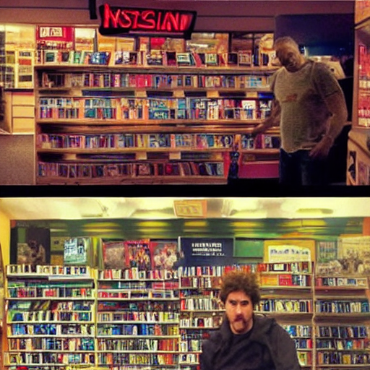
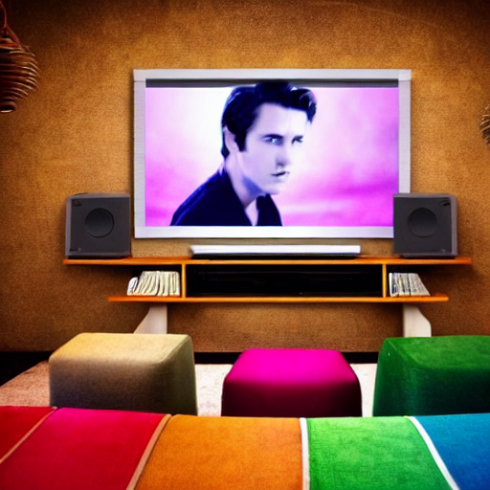
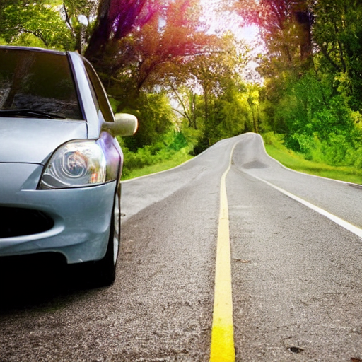
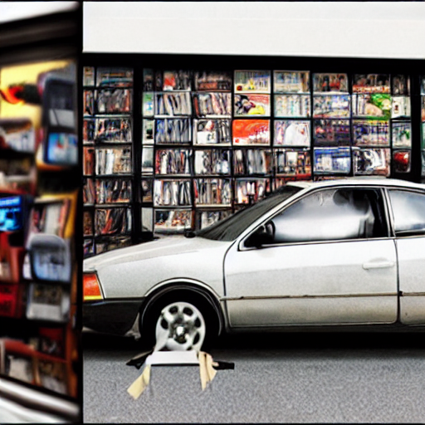


Leveraging Large Language Models for Creative Story Generation
I,
my car,
the road
joy
trust
joy
trust
anticipation
anticipation
[...]
[...]
anger
fear
anger
fear
Background
disgust
sadness
surprise
disgust
sadness
surprise
I wanted to do a different thing than the usual.
joy
trust
joy
trust
anticipation
anticipation
[...]
[...]
anger
fear
anger
fear
I went inside and rented a movie.
I brought the movie home and watched the whole thing.
disgust
sadness
surprise
disgust
sadness
surprise
joy
trust
joy
trust
anticipation
anticipation
I got into my car and went on the road.
[...]
anger
[...]
I stopped at a blockbuster video store
fear
anger
fear
disgust
sadness
surprise
disgust
sadness
surprise
Yuetian Chen & Brendan Capuzzo
User-involved creation
CSCI 4968-01
Machine Learning and Optimization, Spring 2023
I was forced to watch a movie
Thankfully I got home safely.
Notes:
Hi everyone. This is Yuetian.(And I am Bowen) Today we’d like to share with you some ideas presented in our work: “Visual Story Generation Based on Emotional and Keyword Scheme”. This project is also conducted by Ruohua, Peiru who are not with us today. And is also under the guidance of Prof. Si and affiliated with Rensselaer Polytechnic Institute.
In this work, we designed an end-to-end framework that encourage interactive narrative experience based on keyword control and it also comes with automatically generated images for every stage of stories to help users to have a better understanding of story progress. As you can see from the example presented on our right, we used an example from ROCStories dataset, which we will describe in detail later. We can see that the whole story is about Ethan making potatoes. By adjusting the sentiment, our framework enables real-time
plot tree expansion and effectively changes the story direction.
, [work through the picture...]
This is also part of the keywords we offer for modification.

Slide 2
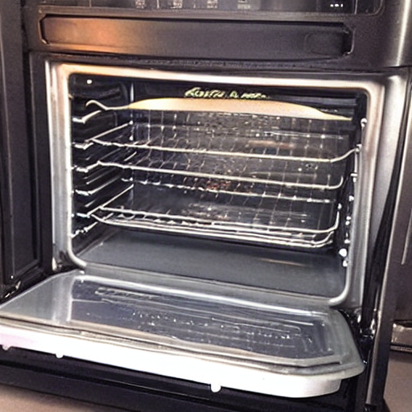
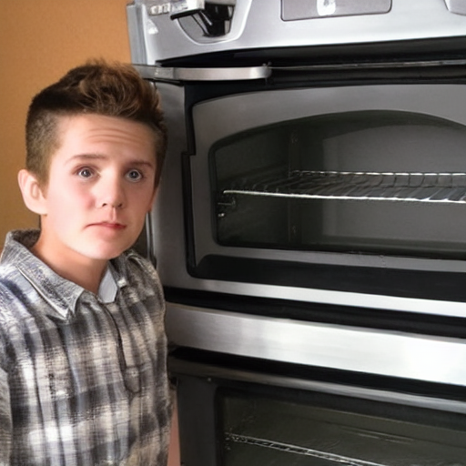
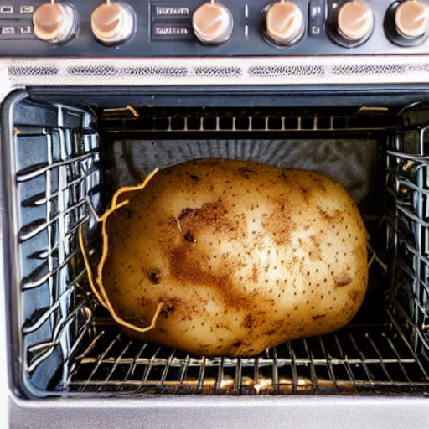
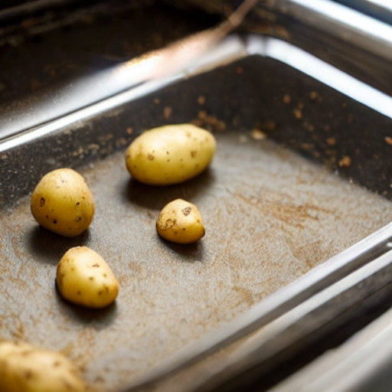
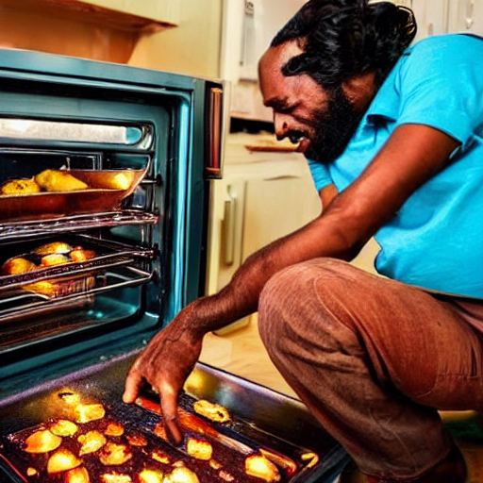

Visual Story Generation Based on Emotional and Keyword Scheme
Ethan turned the oven on.
He put a potato in the oven.
Suddenly, he smelled the potato is burning
Yuetian Chen, Ruohua Li, Bowen Shi, Peiru Liu, & Mei Si
Rensselaer Polytechnic Institute
…
…

Slide 3
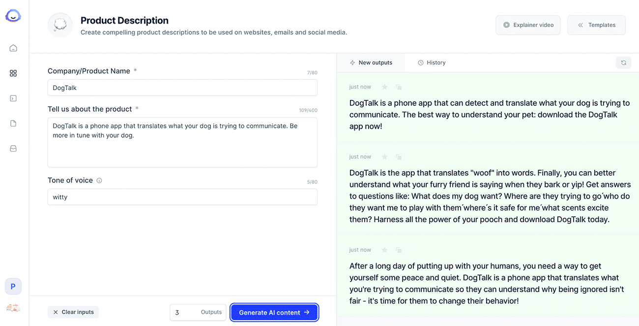
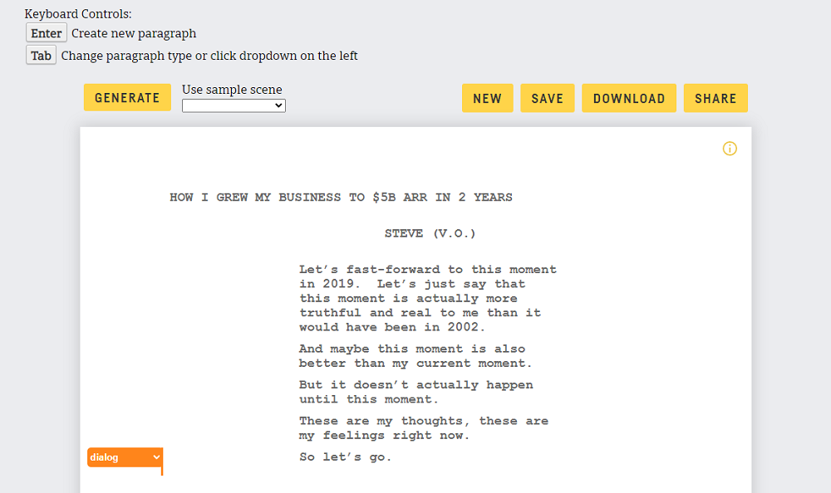
Motivation
Interactive authoring system for story generation
Comercial AI text generators
→ Jasper: https://www.jasper.ai/
→ Rytr: https://rytr.me/
…
No direct control over the generated content
No image generation
→ Even if invoking a separate image generation process
→ Can’t incorporate content from the generated images into future storytelling
Notes:
Presenter:
Brendan
Interactive narrative generation has attracted significant attention from entrepreneurs, as it allows for the creation of stories with high coherence and consistency. Successful efforts have also been made to generate style-guided stories. In the realm of commercial AI text generators, Jasper (https://www.jasper.ai/) and Rytr (https://rytr.me/) are notable examples. However, these platforms have limitations. One, they do not provide direct control over the generated content. Additionally, they lack image generation capabilities, even if a separate image generation process is invoked. Moreover, content from the generated images cannot be incorporated into future storytelling, limiting their potential for multimedia storytelling applications.
Our project explores the idea of controlling story development through a framework where the narrative is controlled using user-specified keywords and emotion labels. To achieve this, we utilize a small dataset for fine-tuning a large language model, leveraging prior knowledge. The emergence of diffusion models has shown promise in surpassing the current state-of-the-art in generative models, including language and image generation. In our work, we propose an interactive visual story generation pipeline that allows users to specify keywords and emotions for the next sentence. Based on this information, the system generates the next sentence and corresponding images for the user to choose from, providing an environment for interactive and controlled story generation. Introducing images to text-based stories enhances immersion in the generated plot. Therefore, we implement an image pipeline that runs parallel to the text pipeline, generating relevant images and additional keywords based on the images as plot suggestions, adding flexibility to the story generation process. The pipeline is divided into two parts: image generation and object detection, where Disco Diffusion and Stable Diffusion are chosen as the primary methods for image generation, and YOLOv5 and Faster RNN are used for object detection. The generated keywords act as suggestions for users to choose from and utilize as hints for guiding the generation process. While our work provides a foundation for the interactive visual narrative generation experience, we acknowledge that there are areas for improvement to enhance the overall experience and the quality of generated results. One key area is improving the coupling between text and visuals, by learning language generation from visual features through a supervisory approach. Additionally, our generated stories and corresponding illustrations exhibit coherence in terms of story progression and adherence to character emotions. Our proposed pipeline aims to co-create visual stories with users, where the narrative and image generation parts work together in harmony.

Slide 4
Related Work
Interactive authoring system for story generation
Neural-based story generation
→ Tambwekar, P.; et al. 2019. Controllable Neural Story Plot Generation via Reward Shaping.
→ Lili Yao; et al. 2019. Plan-and-Write: Towards Better Automatic Storytelling.
Finetuning language model
→ Raffel, C.; et al. 2020. Exploring the Limits of Transfer Learning with a Unified Text-to-Text Transformer.
→ Francisca Adoma Acheampong; et al. 2020.
Text-based emotion detection: Advances, challenges, and opportunities.
Image generation and detection
→ Joseph Redmon; et al. 2016. You Only Look Once: Unified, Real-Time Object Detection
→ Prafulla Dhariwal; et al. 2021. Diffusion Models Beat GANs on Image Synthesis
Notes:
Presenter:
Brendan
Over the past several years, there has been an influx in research work on AI-based story generation. Most recently, model-based generation has attracted a lot of attention. Much of the work since 2019 in this field has revolved around fine-tuning large language models for text generation.
Controllable Neural Story Plot Generation via Reward Shaping
Story generation with large language models has many limitations. Stories can be greatly improved with the control and input from users. Most current language models don’t utilize guidance or control from humans in story generation. In the paper “Controllable Neural Story Plot Generation via Reward Shaping”, the authors discuss a reward-shaping technique that uses reinforcement learning to progress a story from start state to a goal state. Some of those rewards included giving points to the story based on correct grammar, plausible order, makes sense with neighboring sentences, avoids repetition, interesting language, high quality, and is enjoyable.
Plan-And-Write: Towards Better Automatic Storytelling
Text-generation has also proved to provide powerful responses to questions and fetch information for display. Recently, large language models have been used to create long excerpts of text in the form of stories. Human-generated stories can often be highly complex and feature an imaginative plot. Since large-language models rely on text generation and prediction, they don't necessarily "think" on their own. Therefore, many LLM-generated stories lack plot and character development. Recent research in the paper “Plan-And-Write: Towards Better Automatic Storytelling”, the authors describe a "Plan-and-Write" structure for large language models. The process involves a user-generated prompt coupled with a storyline, which is a sequence of words. These words correspond to the progression of the story and each next generated sentence by the LLM should include the word. This automatic storytelling is guided by a liked set of events which include places, actions, and feelings. This research focuses on dynamic and static story generation, which indicates whether the plot adjusts throughout the generation of the story or remains constant from the very beginning.
Exploring the Limits of Transfer Learning with a Unified Text-to-Text Transformer
There is also a lot of research on the T5 model, which is the Text-to-Text Transfer Transformer. This research in “Exploring the Limits of Transfer Learning with a Unified Text-to-Text Transformer” discusses the potential of transfer learning in natural language processing using the T5 model. The authors highlight the great performance of the model on benchmark datasets and discuss limitations and future research directions.
Text-based emotion detection: Advances, challenges, and opportunities
In the article “Text-based emotion detection: Advances, challenges, and opportunities”, the authors talk about using large language models to detect emotions in text excerpts. They present some challenges with emotion detection which include subjective and unclear emotions. There are also challenges with emotions expressed in different cultures as well as bias involved in the interpretation of emotions. Some of the opportunities in the research area include utilizing several modes of communication, like audio and visual, to detect emotions.
You Only Look Once: Unified, Real-Time Object Detection
Another component to our project is the image generation and detection. One such detection method is described in the article “You Only Look Once: Unified, Real-Time Object Detection”. This model is named YOLO and the detection pipeline is a single network, so it performs very fast. Although the model has very high speed, some limitations include the inability to detect small objects.
Diffusion Models Beat GANs on Image Synthesis
Finally, there is some related work in image generation. In the article “Diffusion Models Beat GANs on Image Synthesis”, there is a comparison between diffusion models and Generative Adversarial Networks (GANs) for image synthesis tasks and concludes that diffusion models outperform GANs in terms of image quality and diversity. The article provides a summary of the differences between diffusion models and GANs, highlighting the advantages of diffusion models in generating high-quality images with realistic details and improved sample diversity. The article also discusses the limitations of GANs, such as lack of control over generated images, and how diffusion models address these issues. It concludes that diffusion models are a promising alternative to GANs for image synthesis tasks and offer potential advancements in the field of generative models.

Slide 5

Statement of the work
Interactive authoring system for story generation
Automated Suggester
User Suggestion
Separate authoring need from story composition
→ User-controlled story generation with:
User’s intention on key information
Priori knowledge of language models
Knowledge distillation in finetuning procedure
→ Transfer knowledge to a smaller student model
→ Resulting model is more efficient with reduced computational resources
Image generation prompted by text content
→ Enhance the flexibility in generation
→ Create immersion for design process
→ Provide potential creation suggestions based on image content
Prompt + Teacher LM
Prompt + Student LM
…
…
…
…
Generated Stories
Notes:
Presenter:
Yuetian
And for our framework. The first thing that needs to be made clear is that unlike previous approaches like Rytr or Jasper, that to implement an interactive story generation by modifying the storyline itself, we intend to introduce more control to this process that we can make use of both priori knowledge of language models and user’s creativity that brings immersion and manual control to the plots. By giving the language model the prompt that includes key information, which we will discuss in detail later, in the next stage of the story. This allows the story to be logical while still accepting the evaluation from the users.
As for the controlled image generation implementation, we produced a pipeline based on prompt learning to generate images in real time based on the content provided in the above process to further enhance the flexibility of story generation as well as to further couple the text-to-image process into our framework. In the next slides, we will elaborate further on the challenging part of the implementation of these two points.

Slide 6
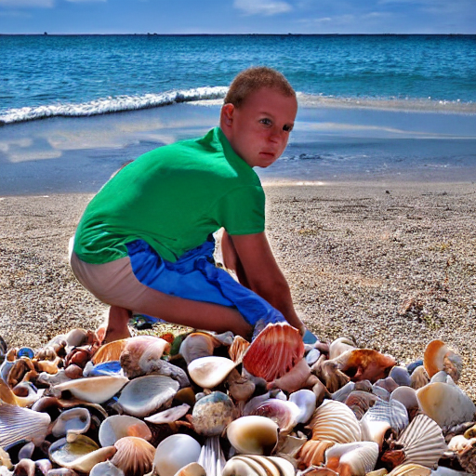



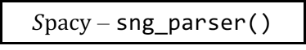



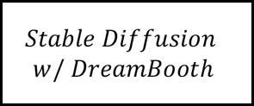
Object Detection
Bring Language Model to Story Generation
Basic Principle: Visual + Text Interactive Generation
Background
Context
Emotion Classifier
Marcus was collecting shells on the beach.
CNN
$${RoBERTa}_{NEXT EMO}$$
He picked up a large beautiful shell.
$${BERT}_{NEXT EMO}$$
Real-time
Keyword Generator
$Spacy$ – sng_parser()
Explicit Key Information
Prompt Template
Object Detection
Object Detection
Keyword
Emotion
Generate next sentence
based on following
<extra_id_0>KEYWORDS: […]
<extra_id_0>CONTEXT: […]
<extra_id_0>EMOTION: […]
Prompt learning
Next Sentence
Generation
User Involvement
Text Pipeline
Visual Pipeline
$$OPT 1.3b$$
$$Stable Diffusion$$
$$w/ DreamBooth$$
Visual & Text
$$T5_{base} Finetuned CommenGen$$
Object Detection
Notes:
But before we enter the next stage, we want to re-emphasize that we want to design a framework that invites the user to control the story generation. Therefore, the above model can only provide a suggestion based on statistically-consistent cognitive habits, and its output is fully modifiable by the user before being imported to the next step. Afterwards, this information will be entered in the appropriate place in the prompt template and carried forward to the next step. In the last step, we run the text as well as the image generation as two pipelines in parallel. The image part will be used to provide users with references and generate keyword recommendations using YOLO or FAST RCNN that can import to the prompt template just as how keyword generator did in the next iteration, while the text part will also iteratively go back to the first step and serve as the context for further content generation. For the text, in order to make the model understand the content and value that each set of information brings, I think we need to start introducing our training strategy and the dataset used.

Slide 7






Object Detection
Bring Language Model to Story Generation
Basic Principle: Visual + Text Interactive Generation
Background
Context
Emotion Classifier
Marcus was collecting shells on the beach.
CNN
$${RoBERTa}_{NEXT EMO}$$
He picked up a large beautiful shell.
$${BERT}_{NEXT EMO}$$
Real-time
Keyword Generator
$Spacy$ – sng_parser()
Explicit Key Information
Prompt Template
Object Detection
Object Detection
Keyword
Emotion
Generate next sentence
based on following
<extra_id_0>KEYWORDS: […]
<extra_id_0>CONTEXT: […]
<extra_id_0>EMOTION: […]
User Involvement
Prompt learning
Next Sentence
Generation
Text Pipeline
Visual Pipeline
Object Detection
$$OPT 1.3b$$
$$Stable Diffusion$$
$$w/ DreamBooth$$
Visual & Text
$$T5_{base} Finetuned CommenGen$$
Object Detection
Notes:
But before we enter the next stage, we want to re-emphasize that we want to design a framework that invites the user to control the story generation. Therefore, the above model can only provide a suggestion based on statistically-consistent cognitive habits, and its output is fully modifiable by the user before being imported to the next step. Afterwards, this information will be entered in the appropriate place in the prompt template and carried forward to the next step. In the last step, we run the text as well as the image generation as two pipelines in parallel. The image part will be used to provide users with references and generate keyword recommendations using YOLO or FAST RCNN that can import to the prompt template just as how keyword generator did in the next iteration, while the text part will also iteratively go back to the first step and serve as the context for further content generation. For the text, in order to make the model understand the content and value that each set of information brings, I think we need to start introducing our training strategy and the dataset used.

Slide 8



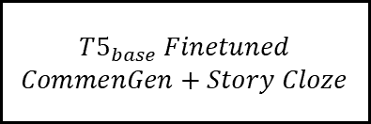


Object Detection
Bring Language Model to Story Generation
Basic Principle: Visual + Text Interactive Generation
Background
Context
Emotion Classifier
Marcus was collecting shells on the beach.
CNN
He picked up a large beautiful shell.
Real-time
Keyword Generator
Explicit Key Information
Prompt Template
Object Detection
Object Detection
Keyword
Emotion
Generate next sentence
based on following
<extra_id_0>KEYWORDS: […]
<extra_id_0>CONTEXT: […]
<extra_id_0>EMOTION: […]
User Involvement
Prompt learning
Next Sentence
Generation
Text Pipeline
Visual Pipeline
Object Detection
Visual & Text
Object Detection

Slide 9
Story Co-generation with Prompting Learning
1. Current Situation of Short Narrative Creation
Previous Work: Automatic Story Generation Task
Fundamental Challenges of Context-based Generation
2. Bring Language Model to Story Generation
Basic Principle: Visual + Text Interactive Generation
3. Implementation of an End-to-end Pipeline
Part 1 – Text pipeline
→ Named Entities + Sentiments Label + Context = Controlled story…
Part 2 – Image pipeline
→ Generated stylized illustrations using Stable Diffusion, Disco Diffusion …
4. Advantages on Narrative Co-generation
Demo
5. Future Improvement on Prompting and Framework Strcture
Continuous prompting…

Slide 10
Current Situation of Short Narrative Creation
Previous Work: Automatic Story Generation Task
Automated planning & scheduling based
→ Story generation planning based on decision theory
Tale-Spin (Meehan, 1976),
CBR-based system(Gervás, 2005),
IPOCL planner(Riedl, 2010)
Natural language model based
Plot centric story generation guided by story corpus
skip-thought vectors(Kiros, 2015)
CaTeRS (Mostafazadeh, 2016)

Slide 11
Current Situation of Short Narrative Creation
Dataset Format & Story Generation Process
Automated Suggester
User Suggestion
Prompt + Language Model
…
…
…
…
Generated Stories

Slide 12
Implementation of an End-to-end Pipeline
Dataset Format & Story Generation Process
ROCStories (Story Cloze Test)
→ A dataset evaluating narrative structure learning
98,159 stories
→ Each story has a similar structure
Short narrative with five sentences
Logic & progression between sentences
Writing Prompts
→ 303,358 pairs of writing prompts and human- written stories
→ Sourced from Reddit's r/WritingPrompts forum
→ Diverse topics, lengths, and ideas
index | Sentence
0 | Marcus was collecting shells on the beach.
1 | He picked up a large beautiful shell.
2 | He put it in his pocket to save for later.
3 | Suddenly he felt a sharp pinch.
4 | A crab was inside the shell pinching his leg.
index | Sentence
0 | Oswald decided to write a novel.
1 | He worked on his book for several months.
2 | Oswald took his book to a publisher.
3 | The publisher rejected his book almost immediately.
4 | Oswald decided to give up on writing.
Sample narratives quoted from Story Cloze
Notes:
And now, let's go back to the first point, where we will further start discussing the details of our implementation of the text pipeline and how to use it. Here, as we mentioned before, as a replacement for the storyline modification, we use the existing background sentences as a priori knowledge by which we can predict two pieces of information as our key elements. One is the key named entity, which we will shorten as the keyword in following, in the next sentence while the other is the sentiment label. In addition to letting the user do the input manually, we have implemented both automatic suggester that predict both information based on the BERT-like as well as a large-scale language model named OPT(Open Pre-trained Transformer Language Models).
To finetuning these language model, we mainly used story content based on ROCStories as our dataset, where each group of stories consists of five sentences and during the crowdsourcing process, narrative creator was asked to make sure that stories are making progress while keep its coherent and consistency. Specifically, some sample stories are placed on your right-hand side, where we can see that…

Slide 13
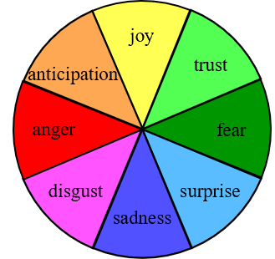
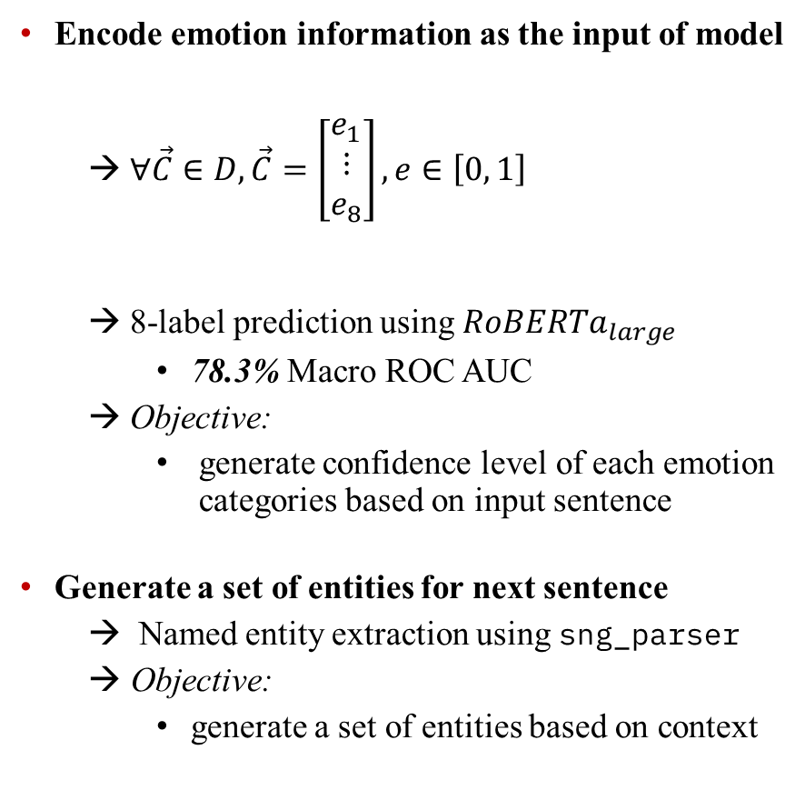


Implementation of an End-to-end Pipeline
Text pipeline
Encode emotion information as the input of model
→ $∀\vec{C}∈D, \vec{C}=\left[\begin{matrix}e_{1} \\ ⋮ \\ e_{8}\end{matrix}\right], e∈\left[0, 1\right]$
→ 8-label prediction using ${RoBERTa}_{large}$
78.3% Macro ROC AUC
→ Objective:
generate confidence level of each emotion categories based on input sentence
Generate a set of entities for next sentence
→ Named entity extraction using sng_parser
Objective:
generate a set of entities based on context
Context
Emotion
Named Entity
Kevin went to the beach with his wife one day.
They went into the water and began to swim around.
fear,
surprise,
sadness,
disgust,
anger
joy
Kevin,
foot
anticipation
trust
anger
fear
disgust
sadness
surprise
Prompt Template
$$OPT 1.3B$$
$$T5_{base} Finetuned CommenGen$$
Generated Next Sentence
Suddenly, Kevin felt a sharp pain in his foot.
Notes:
The story alone is not enough, we also need to visualize some additional information in the story, including emotions and characters serves as the keyword. So, we also used Story Commonsense as an additional dataset. The stories section is a subset of ROCStories and contains a sample of 15,000 stories, which is quite a bit less than the nearly 100,000 samples in ROCStories. but on top of it, it contains additional information for each story, including sentiment, motivation, character quest, etc. Here we use categorical sentiment annotation, which uses Plutchik’s wheel of emotion model that using the following 8 emotions for each stage of stories to express the emotions of the main character in the story, including …
As for the implementation of the suggester, on the sentiment predictor, we predicted the 8-class sentiment as a one-hot vector, with each entry representing one sentiment. That is, the goal of the model is reduced to a multi-label classification, that predicting the confidence level of each entry in an array of length 8. And at the end, we achieved 78.3% of the macro ROC-AUC in the prediction. Meaning that it can make valid sentiment predictions and provide quite reasonable suggestions.
As for named entities, we use sng_parser to generate named entities that have appeared before for users to choose from. In addition to this, we used the full ROCStories dataset and sng_parser again for the extraction of named entities for the next sentence. Finally, they were imported into the large-scale language model to encourage OPT to have a prediction of the named entity for the next sentence. and we can then obtain a recommender that provides named entities in a decent accuracy
By combining both results, this gives us the key information, but it's not enough for story generation, so let's go back to the previous page and further explain how to use this information next

Slide 14
Object Detection
Bring Language Model to Story Generation
Basic Principle: Visual + Text Interactive Generation
Background
Context
Emotion Classifier
Marcus was collecting shells on the beach.
CNN
$${RoBERTa}_{NEXT EMO}$$
He picked up a large beautiful shell.
$${BERT}_{NEXT EMO}$$
Real-time
Keyword Generator
$Spacy$ – sng_parser()
Explicit Key Information
Prompt Template
Object Detection
Object Detection
Keyword
Emotion
Generate next sentence
based on following
<extra_id_0>KEYWORDS: […]
<extra_id_0>CONTEXT: […]
<extra_id_0>EMOTION: […]
Prompt learning
Next Sentence
Generation
User Involvement
Text Pipeline
Visual Pipeline
$$OPT 1.3b$$
$$Stable Diffusion$$
$$w/ DreamBooth$$
Visual & Text
$$T5_{base} Finetuned CommenGen$$
Object Detection
Notes:
But before we enter the next stage, we want to re-emphasize that we want to design a framework that invites the user to control the story generation. Therefore, the above model can only provide a suggestion based on statistically-consistent cognitive habits, and its output is fully modifiable by the user before being imported to the next step. Afterwards, this information will be entered in the appropriate place in the prompt template and carried forward to the next step. In the last step, we run the text as well as the image generation as two pipelines in parallel. The image part will be used to provide users with references and generate keyword recommendations using YOLO or FAST RCNN that can import to the prompt template just as how keyword generator did in the next iteration, while the text part will also iteratively go back to the first step and serve as the context for further content generation. For the text, in order to make the model understand the content and value that each set of information brings, I think we need to start introducing our training strategy and the dataset used.

Slide 15

Current Situation of Short Narrative Creation
Fundamental Challenges of Automatic Context-based Generation
Consistency
→ No internal contradiction of story elements
properties & events of word & characters
Coherence
Events should be logically explainable
Help reader build up casual representation of events
Motivation
→ Story ≠ Predicting behavior
→ Justified surprise is fine
→ Author provides action & make actions
reasonable to reader
Ray couldn't get an irritating tune out of his head.
Next Sentence Prediction
He fell in love with the tune
Her psychiatrist diagnosed her with depression after seeing her.
Next Sentence Prediction
She was very happy.
I went to the harbor yesterday
Next Sentence Prediction
I was eating a lot of fish.
Sample provided by Zero-shot $T5_{base}$

Slide 16
Current Situation of Short Narrative Creation
Dataset Format & Story Generation Process
Story Cloze Test
→ A dataset evaluating narrative structure learning
→ Each story has a similar structure
Consists of five sentences
Contain twists of events in the middle stages
Story Commonsense
→ Use subset of Story Cloze as the basis
15,000 stories
→ Provide Plutchik’s annotation for each plot
joy, trust, fear, surprise, sadness, anticipation, anger, & disgust
index | Sentence
0 | Marcus was collecting shells on the beach.
1 | He picked up a large beautiful shell.
2 | He put it in his pocket to save for later.
3 | Suddenly he felt a sharp pinch.
4 | A crab was inside the shell pinching his leg.
A sample narrative quoted from Story Cloze

Slide 17




Bring Language Model to Story Generation
Basic Principle: Visual + Text Interactive Generation
Background
Context
Emotion Classifier
Marcus was collecting shells on the beach.
CNN
$${RoBERTa}_{NEXT EMO}$$
He picked up a large beautiful shell.
$${BERT}_{NEXT EMO}$$
Real-time
Keyword Generator
$$OPT_{1.5B}$$
Explicit Key Information
Prompt Template
Keyword
Emotion
Generate next sentence
based on following
<extra_id_0>KEYWORDS: […]
<extra_id_0>CONTEXT: […]
<extra_id_0>EMOTION: […]
User Involvement
Prompt learning
Next Sentence
Generation
Text Pipeline
Visual Pipeline
$$T5_{base} Finetuned$$
$CommenGen+Story Cloze$
$$Disco Diffusion$$
Visual & Text
$$Stable Diffusion$$

Slide 18

Implementation of an End-to-end Pipeline
Text pipeline
Multi-task training on multiple datasets
→ CommenGen
Constrained text generation task
Objective: Vocabulary-based sentence construction
→ Story Commonsense
Bring keywords and prompt template to task
Objective: Generate next sentence based on input
Interactive short narrative generation
Based on user-provided story background
Generate next sentence based on a triad of data
Context
Named entity
Plutchik's wheel of emotions label
Context
Emotion
Named Entity
Kevin went to the beach with his wife one day.
They went into the water and began to swim around.
fear,
surprise,
sadness,
disgust,
anger
joy
Kevin,
foot
anticipation
trust
anger
fear
disgust
sadness
surprise
Prompt Template
$$T5_{base} Finetuned$$
$CommenGen+Story Commonsense$
Generated Next Sentence
Suddenly, Kevin felt a sharp pain in his foot.

Slide 19


Implementation of an End-to-end Pipeline
Text pipeline – Teacher Model
Teacher network: OPT 1.3B
→ Source of knowledge for the student model
→ Large, pre-trained language model
→ Trained on massive datasets; capture intricate patterns and relationships
Architectural enhancements
→ Different positional encoding for processing large inputs
→ Contributes to coherent, contextually appropriate text generation
Context
Emotion
Named Entity
Kevin went to the beach with his wife one day.
They went into the water and began to swim around.
fear,
surprise,
sadness,
disgust,
anger
joy
Kevin,
foot
anticipation
trust
anger
fear
disgust
sadness
surprise
Model | # Parameters | Comparison
OPT 1.3B | 1,300,000,000 (1.3b) | OPT is 5.9x more than T5
T5-Base | 220,000,000 (220m)
Prompt Template
$$OPT 1.3B$$
$$T5_{base} Finetuned CommenGen$$
Generated Next Sentence
Suddenly, Kevin felt a sharp pain in his foot.
Notes:
In the Text pipeline, the language model we used is a T5 with finetuned CommenGen published by Manu Romero in huggingface community. By finetuning this dataset, we can gain sentences based on keyword entered. Specifically, when the input value is
The reason of selection of this model is that we want the model to be able to use the experience gained in this part of the task when performing controlled prediction tasks, that we discussed in following, so that the named entities in left-side can be effectively inserted into the next sentence generated on the right
And for our formal task that brings keywords and prompt template to task, we are now able to set context, named entity and sentiment into the template and serves as the input to get the sentence we want

Slide 20
Implementation of an End-to-end Pipeline
Text pipeline – Student Model
Multi-task pre-training on multiple datasets
→ CommenGen
mrm8488/t5-base-finetuned-common_gen
Constrained text generation task
Objective:
Vocabulary-based sentence construction
→ Story Commonsense
Bring keywords and prompt template to task
Objective:
Generate next sentence based on input
Context
Emotion
Named Entity
Kevin went to the beach with his wife one day.
They went into the water and began to swim around.
fear,
surprise,
sadness,
disgust,
anger
joy
Kevin,
foot
anticipation
trust
anger
fear
disgust
sadness
surprise
man
Prompt Template
hole
LM
A man is digging a hole near a tree
tree
$$OPT 1.3B$$
$$T5_{base} Finetuned CommenGen$$
Generated Next Sentence
Context
LM
Next plot
Suddenly, Kevin felt a sharp pain in his foot.
Keyword
Sentiment
Notes:
In the Text pipeline, the language model we used is a T5 with finetuned CommenGen published by Manu Romero in huggingface community. By finetuning this dataset, we can gain sentences based on keyword entered. Specifically, when the input value is
The reason of selection of this model is that we want the model to be able to use the experience gained in this part of the task when performing controlled prediction tasks, that we discussed in following, so that the named entities in left-side can be effectively inserted into the next sentence generated on the right
And for our formal task that brings keywords and prompt template to task, we are now able to set context, named entity and sentiment into the template and serves as the input to get the sentence we want

Slide 21
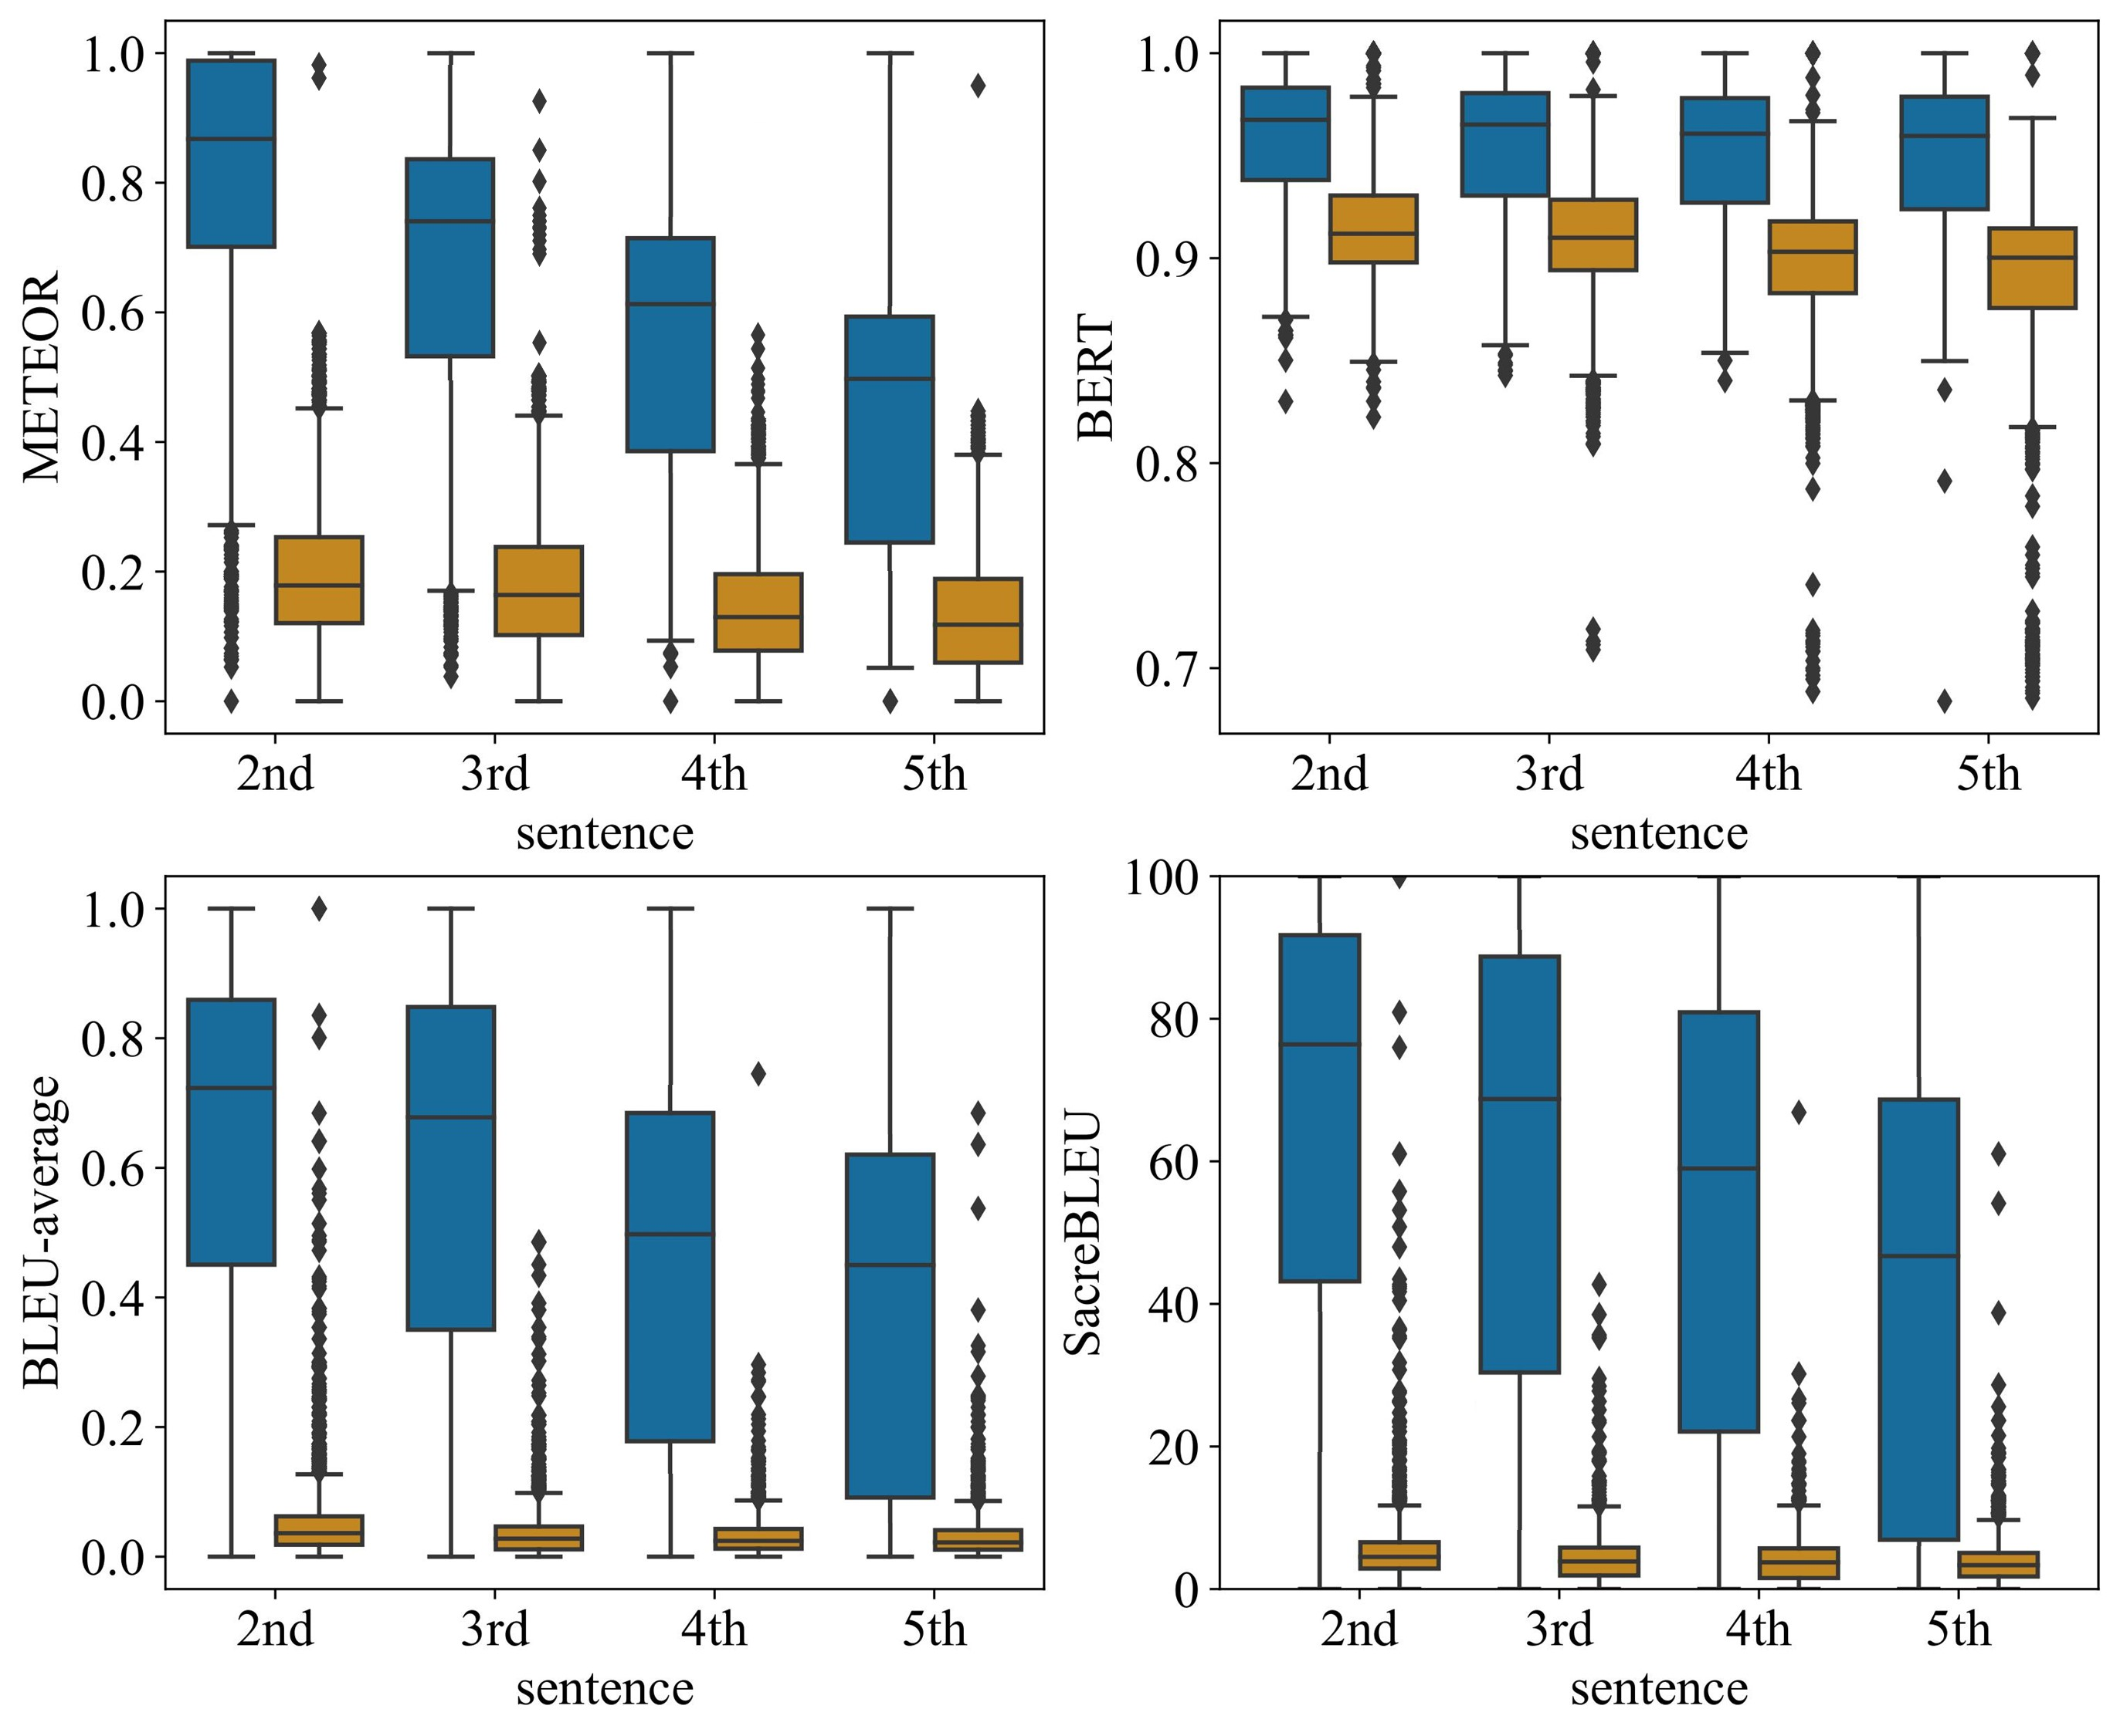
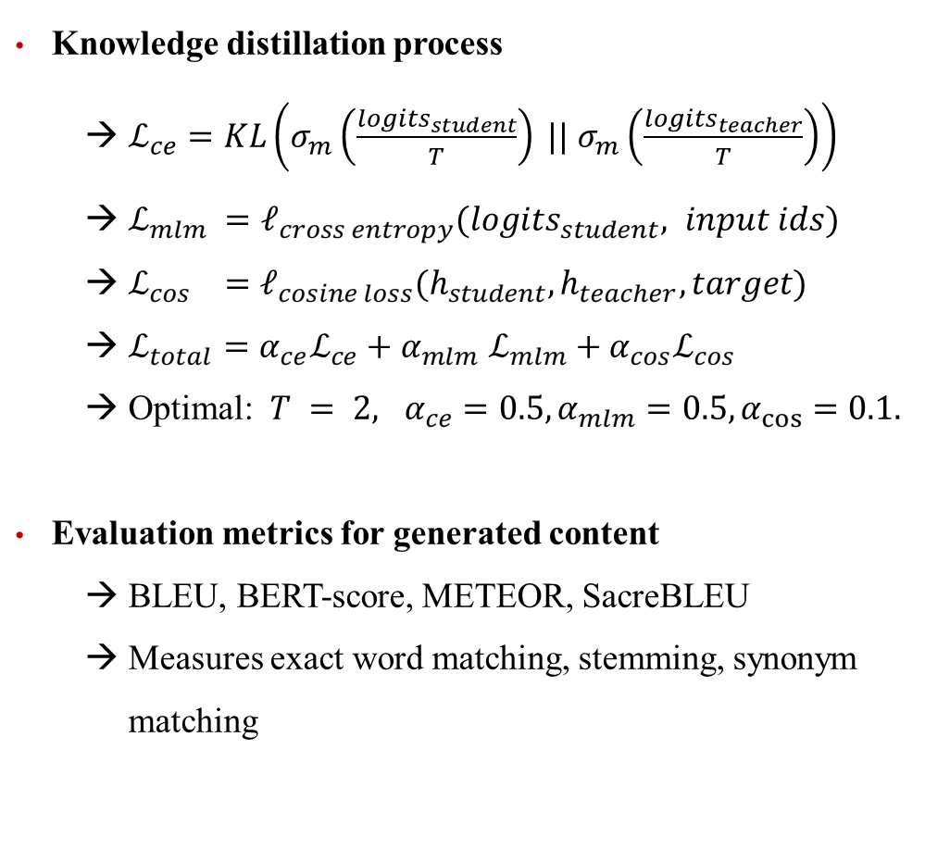
Implementation of an End-to-end Pipeline
Text pipeline – Implementation & Evaluation
Knowledge distillation process
→ $ℒ_{ce}=KL\left(σ_{m}\left(\frac{logits_{student}}{T}\right) || σ_{m}\left(\frac{logits_{teacher}}{T}\right)\right)$
→ $ℒ_{mlm} =ℓ_{cross entropy}(logits_{student}, input ids)$
→ $ℒ_{cos} =ℓ_{cosine loss}(h_{student}, h_{teacher}, target)$
→ $ℒ_{total}=α_{ce}ℒ_{ce}+α_{mlm}$ $ℒ_{mlm}+α_{cos}ℒ_{cos}$
→ Optimal: $T = 2, α_{ce}=0.5, α_{mlm}=0.5, α_{cos}=0.1.$
Evaluation metrics for generated content
→ BLEU, BERT-score, METEOR, SacreBLEU
→ Measures exact word matching, stemming, synonym matching
Experimental results
→ Improvements in evaluation metrics compared to baseline model
→ Emotions, keywords, and knowledge distillation enhance story generation quality
Notes:
In the Text pipeline, the language model we used is a T5 with finetuned CommenGen published by Manu Romero in huggingface community. By finetuning this dataset, we can gain sentences based on keyword entered. Specifically, when the input value is
The reason of selection of this model is that we want the model to be able to use the experience gained in this part of the task when performing controlled prediction tasks, that we discussed in following, so that the named entities in left-side can be effectively inserted into the next sentence generated on the right
And for our formal task that brings keywords and prompt template to task, we are now able to set context, named entity and sentiment into the template and serves as the input to get the sentence we want

Slide 22
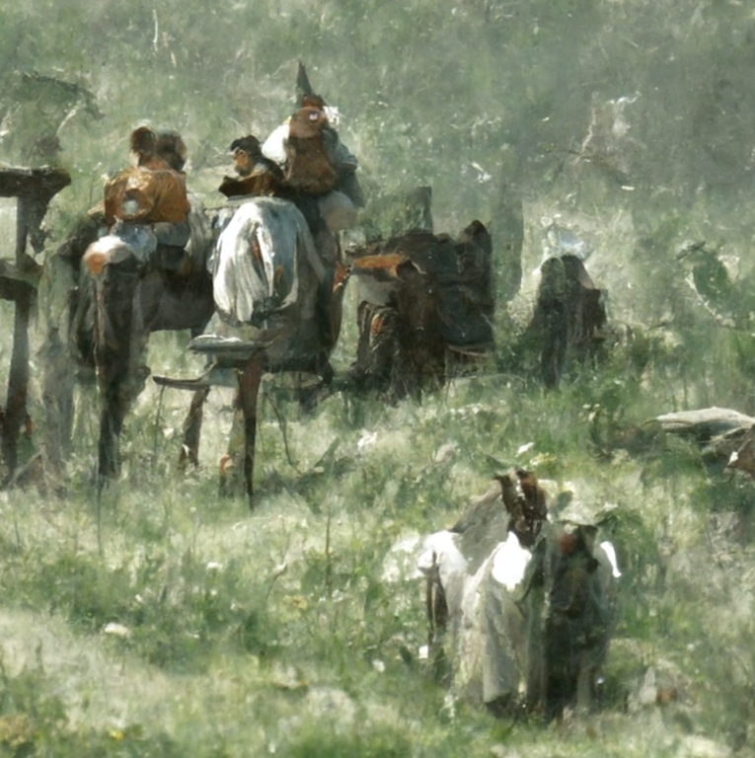
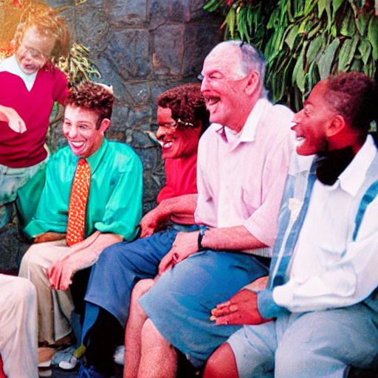
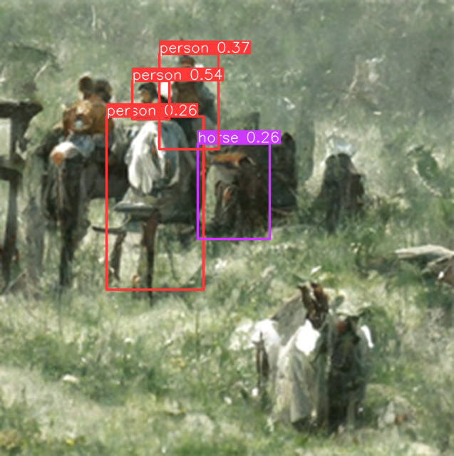
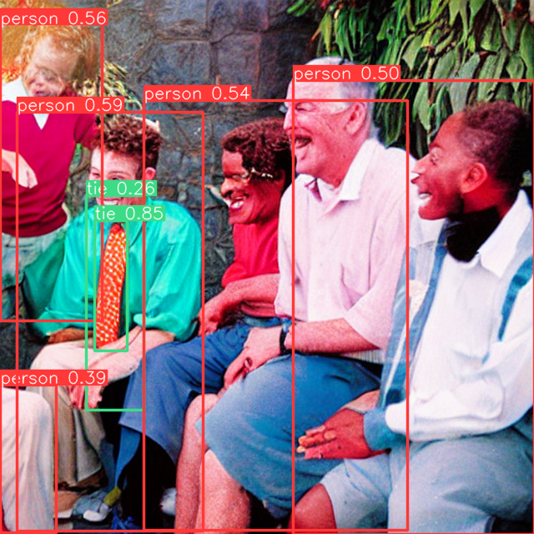
Advantages on Narrative Co-generation
Visual pipeline
Image generation from pure narratives
Enhance the flexibility in generation
Create immersion for design process
Provide potential creation suggestions based on image content
Potential challenges of sentence-based generation
→ No association information between images
Character and Environment Features
Image style
→ Inaccurate object recognition results
Variable quality of image generation
Bias in object recognition dataset
Weak zero-shot inference capability
“Ray gathered his friends to tell them a funny joke he heard.”

Slide 23
Advantages on Narrative Co-generation
Visual pipeline
Image generation from pure narratives
Prompt template
→ Disco Diffusion
Produce relevant figures with artistic quality
Carl Spitzweg splash-art style
→ Stable Diffusion
More robust drawing for character structure
Realistic photography style
Image feature extraction by target detection
→ Results combining from YOLOv5 & Faster R-CNN
→ Confidence level as a recommendation strength metric
“A colorful photo telling a story about [CONTEXT]”
“Ray gathered his friends to tell them a funny joke he heard.”
Notes:
Presenter: Brendan

Slide 24
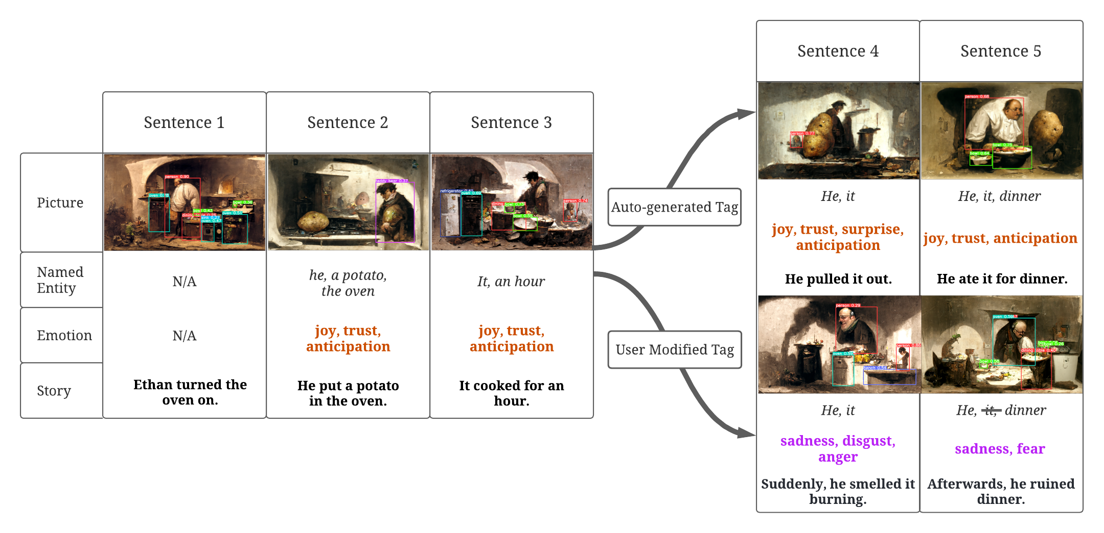
Advantages on Narrative Co-generation
Demo
Controlled interactive story generation
User can modify suggested keywords for real-time plot changes based on requirements

Slide 25
Demo
http://vsg-ek.herokuapp.com/
Notes:
And here is our demo time!
0
[Emotion]
[Keyword]
Oswald decided to write a novel.
[generate image using this]
1
joy, trust, anticipation
Plan A: He, book, month
Plan B: He, book
A: He worked on his book for several months.
B: he worked on the book all summer
2
joy, anticipation
Oswald, the book, publisher
Oswald took the book to a publisher.
3
Plan A:
fear, sadness, disgust
Plan B:
joy, trust, surprise
publisher, book
A: The publisher rejected his book almost immediately.
B: a publisher agreed publish the book.
4
[Follow B]
book, Oswald
the book was discovered and Oswald was happy.

Slide 26
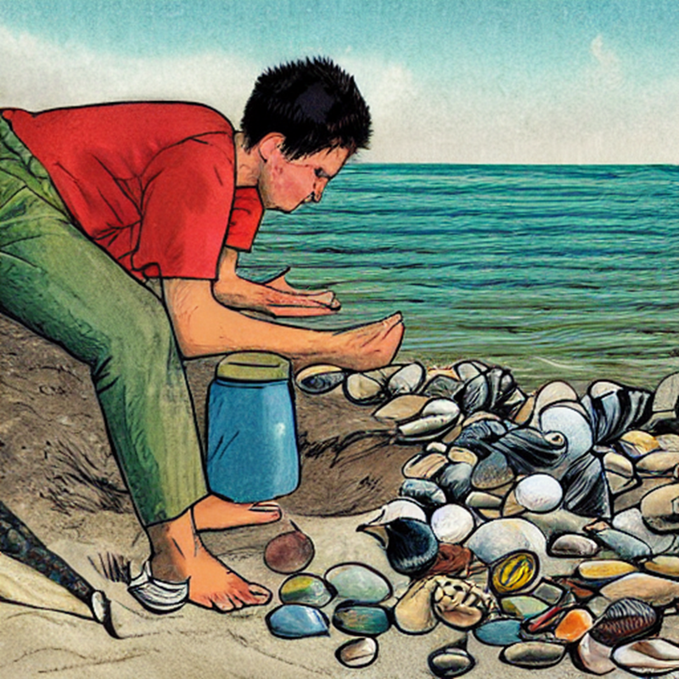
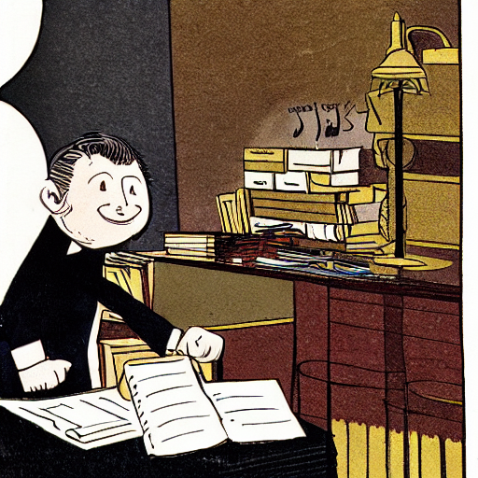
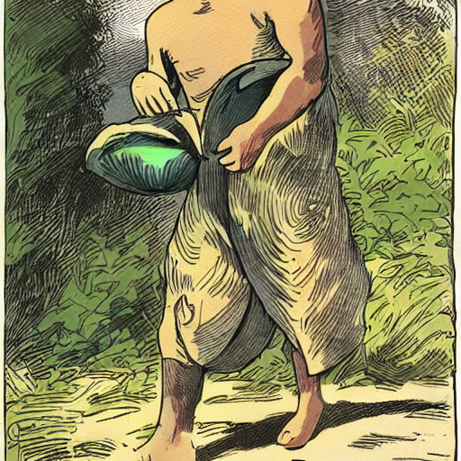
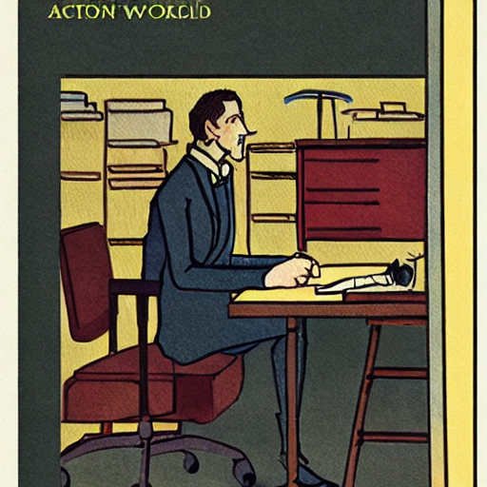

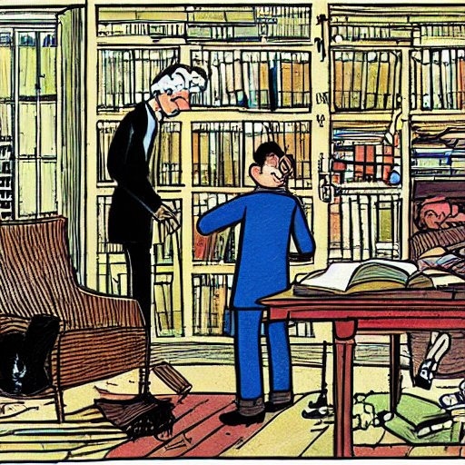
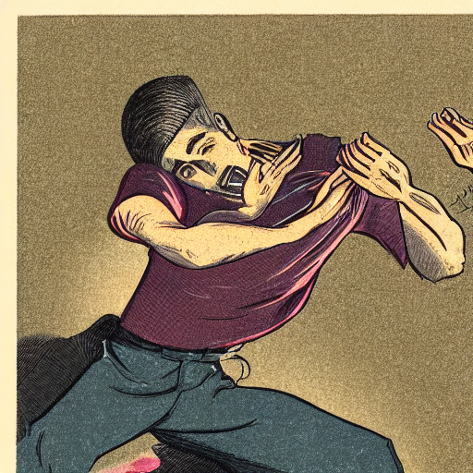
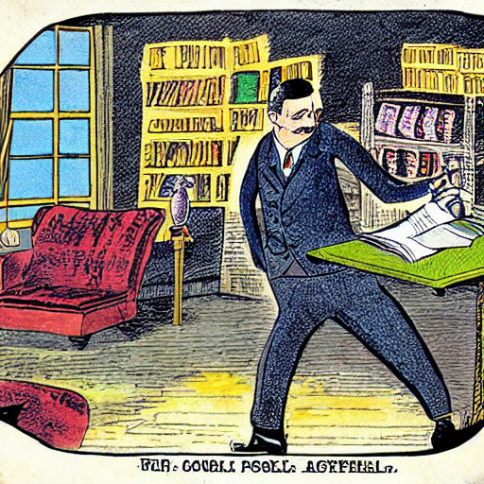
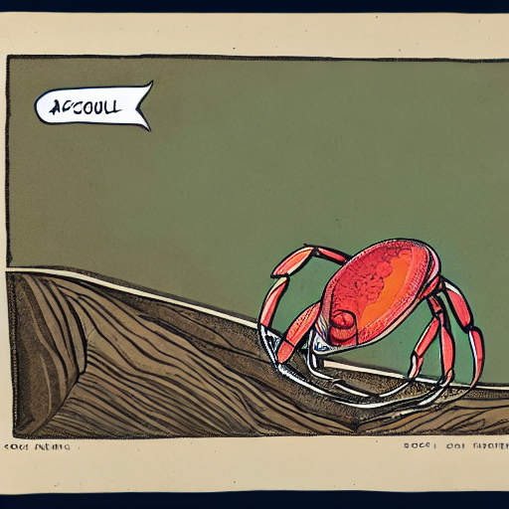
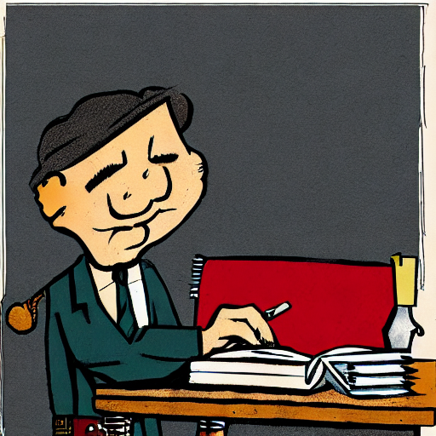
Advantages on Narrative Co-generation
Demo - sample generation results
# | Sentence
0 | Marcus was collecting shells on the beach.
1 | He picked up a large beautiful shell.
2 | He put it in his pocket to save for later.
3 | Suddenly he felt a sharp pinch.
4 | A crab was inside the shell pinching his leg.
# | Sentence
0 | Oswald decided to write a novel.
1 | He worked on his book for several months.
2 | Oswald took his book to a publisher.
3 | The publisher rejected his book almost immediately.
4 | Oswald decided to give up on writing.
# | Sentence
0 | Marcus was collecting shells on the beach.
1 | He picked up a large beautiful shell.
2 | He put it in his pocket to save for later.
3 | Suddenly he felt a sharp pinch.
4 | A crab was inside the shell pinching his leg.
# | Sentence
0 | Oswald decided to write a novel.
1 | He worked on his book for several months.
2 | Oswald took his book to a publisher.
3 | The publisher rejected his book almost immediately.
4 | Oswald decided to give up on writing.
...
Notes:
Presenter: Brendan

Slide 27
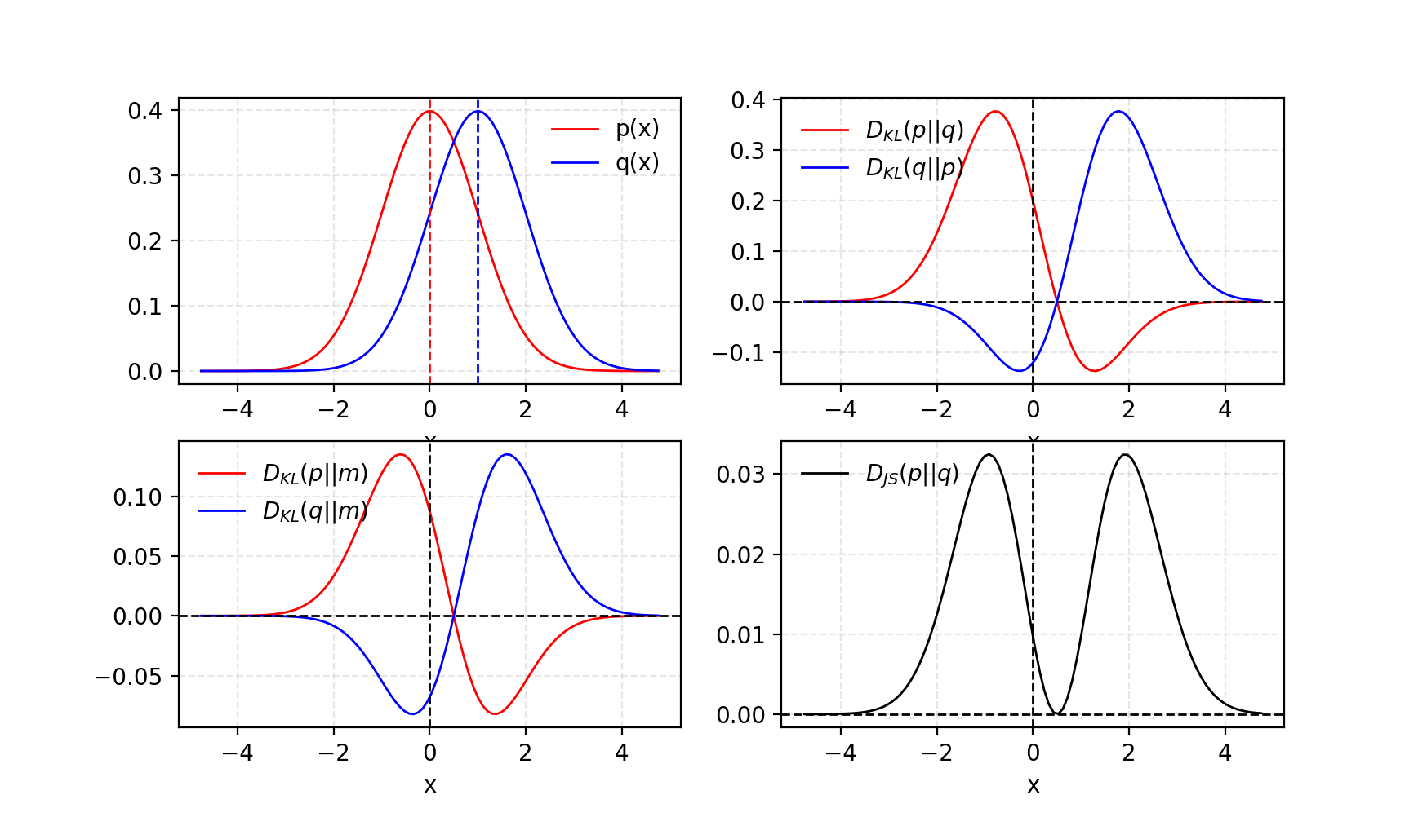
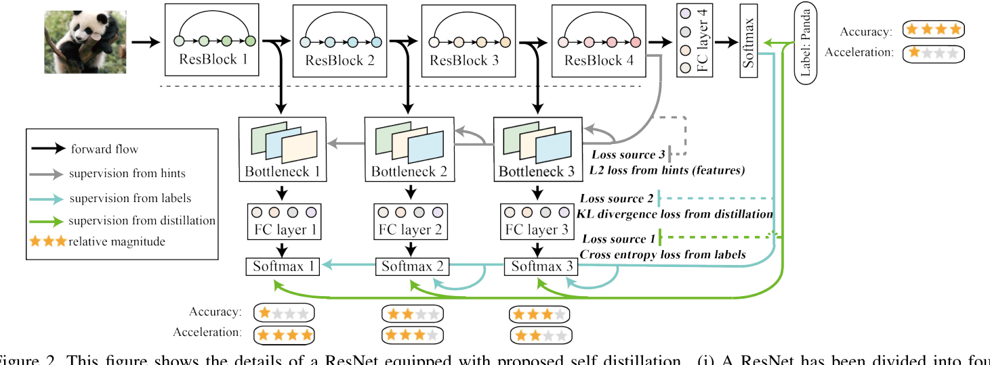
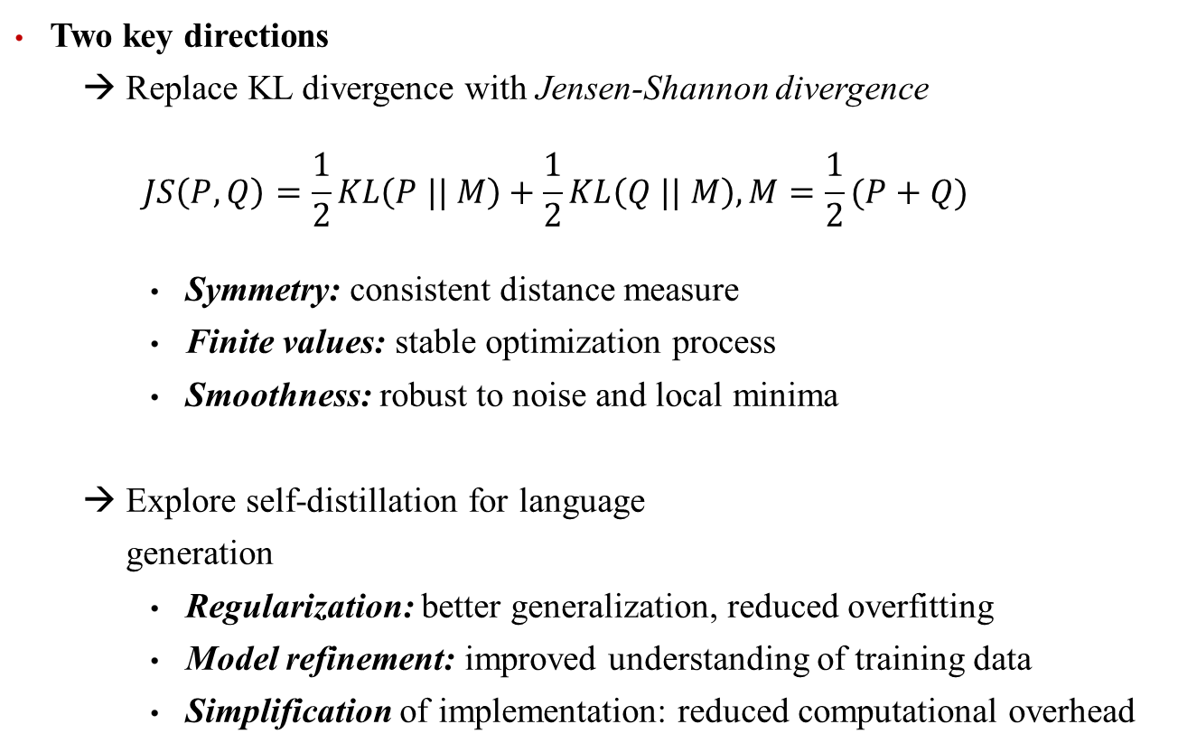
Future Works & Conclusion
Visual Story Generation Based on Emotional and Keyword Scheme
Two key directions
→ Replace KL divergence with Jensen-Shannon divergence
$$JS\left(P, Q\right)=\frac{1}{2}KL\left(P || M\right)+\frac{1}{2}KL\left(Q || M\right),M=\frac{1}{2}(P+Q)$$
Symmetry: consistent distance measure
Finite values: stable optimization process
Smoothness: robust to noise and local minima
→ Explore self-distillation for language generation
Regularization: better generalization, reduced overfitting
Model refinement: improved understanding of training data
Simplification of implementation: reduced computational overhead
Notes:
Presenter: Brendan

Slide 28
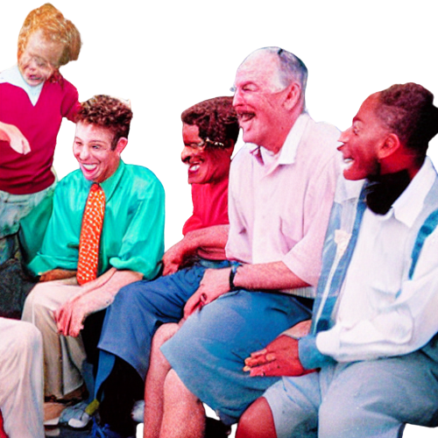
Future Improvement on Prompting and Model Selection
Performance-oriented optimization
Entities Extraction
Increase the scale of generated stories
Expand the number of sentences
Increase plot diversity
Prompting Optimization
→ Enable the model to further understand the task
Continuous prompting
Inductively valid template
→ Ensure the unity of the direct elements of the picture
Image prompting
…
Enhance the coupling between text and visual
→ Learning language generation from visual features supervision
Next Sentence from Text Pipe
Generated Image for Next Sentence

Slide 29
Reference
Banerjee, S., and Lavie, A. 2005. METEOR: An automatic metric for MT evaluation with improved correlation with human judgments. In Proceedings of the ACL Work- shop on Intrinsic and Extrinsic Evaluation Measures for Machine Translation and/or Summarization, 65–72. Ann Arbor, Michigan: Association for Computational Linguistics.
Fan, A.; Lewis, M.; and Dauphin, Y. 2018. Hierarchical neural story generation. In Proceedings of the 56th Annual Meeting of the Association for Computational Linguistics (Volume 1: Long Papers), 889–898. Melbourne, Australia: Association for Computational Linguistics.
Gerv ́as, P.; D ́ıaz-Agudo, B.; Peinado, F.; and Herv ́as, R. 2005. Story plot generation based on cbr. In Knowl. Based Syst.
Ibrahim, B. I. E.; Eyharabide, V.; Le Page, V.; and Billiet, F. 2022. Few-shot object detection: Application to medieval musicological studies. Journal of Imaging 8(2).
Kiros, R.; Zhu, Y.; Salakhutdinov, R. R.; Zemel, R.; Urta- sun, R.; Torralba, A.; and Fidler, S. 2015. Skip-thought vectors. In Cortes, C.; Lawrence, N.; Lee, D.; Sugiyama, M.; and Garnett, R., eds., Advances in Neural Information Processing Systems, volume 28. Curran Associates, Inc.
Li, B.; Lee-Urban, S.; Johnston, G.; and Riedl, M. 2013. Story generation with crowdsourced plot graphs. Proceed- ings of the 27th AAAI Conference on Artificial Intelligence, AAAI 2013 598–604.
Lin, C.-Y., and Och, F. J. 2004. ORANGE: a method for evaluating automatic evaluation metrics for machine trans- lation. In COLING 2004: Proceedings of the 20th Interna- tional Conference on Computational Linguistics, 501–507. Geneva, Switzerland: COLING.
Lin, T.-Y.; Maire, M.; Belongie, S.; Bourdev, L.; Girshick, R.; Hays, J.; Perona, P.; Ramanan, D.; Zitnick, C. L.; and Doll ́ar, P. 2014. Microsoft coco: Common objects in context.
Lin, T.-Y.; Doll ́ar, P.; Girshick, R.; He, K.; Hariharan, B.; and Belongie, S. 2016. Feature pyramid networks for object detection.
Lin, B. Y.; Zhou, W.; Shen, M.; Zhou, P.; Bhagavatula, C.; Choi, Y.; and Ren, X. 2019. Commongen: A constrained text generation challenge for generative commonsense rea- soning. arXiv preprint arXiv:1911.03705.
Liu, D.; Li, J.; Yu, M.-H.; Huang, Z.; Liu, G.; Zhao, D.; and Yan, R. 2020. A character-centric neural model for auto- mated story generation. Proceedings of the AAAI Confer- ence on Artificial Intelligence 34(02):1725–1732.
Meehan, J. R. 1977. Tale-spin, an interactive program that writes stories. In IJCAI.
Montfort, N. 2007. Generating narrative variation in inter- active fiction. Dissertations available from ProQuest.
Mostafazadeh, N.; Chambers, N.; He, X.; Parikh, D.; Batra, D.; Vanderwende, L.; Kohli, P.; and Allen, J. 2016a. A corpus and evaluation framework for deeper understanding of commonsense stories. arXiv preprint arXiv:1604.01696.
Mostafazadeh, N.; Grealish, A.; Chambers, N.; Allen, J.; and Vanderwende, L. 2016b. CaTeRS: Causal and temporal re- lation scheme for semantic annotation of event structures. In Proceedings of the Fourth Workshop on Events, 51–61. San Diego, California: Association for Computational Linguis- tics.
Onega, S., and Landa, J. A. G. 2014. Narratology: an intro- duction. Routledge.
Post, M. 2018. A call for clarity in reporting BLEU scores. In Proceedings of the Third Conference on Machine Trans- lation: Research Papers, 186–191. Belgium, Brussels: As- sociation for Computational Linguistics.
Radford, A.; Kim, J. W.; Hallacy, C.; Ramesh, A.; Goh, G.; Agarwal, S.; Sastry, G.; Askell, A.; Mishkin, P.; Clark, J.; Krueger, G.; and Sutskever, I. 2021. Learning transferable visual models from natural language supervision.

Slide 30
Q & A
1. State-of-the-art Work of Short Narrative Creation
Separate authoring need from story composition need
Prompt-based learning for image generation
2. Statement of the work
Basic Principle: Visual + Text Interactive Generation
3. Implementation of an End-to-end Pipeline
Part 1 – Text pipeline
→ Named Entities + Sentiments Label + Context = Controlled story…
Part 2 – Image pipeline
→ Generated stylized illustrations using Stable Diffusion, Disco Diffusion …
4. Advantages on Narrative Co-generation
Modify suggested keywords for real-time plot changes based on requirements
5. Future Improvement on Prompting and Framework Strcture
Scale increasing & prompting optimization…

